Slide 1
Zoom meeting housekeeping rules
All attendees need to be muted and please remain muted for the duration of the meeting.
Please rename yourself to include your full first name and first initial of your last name, your kid’s grade (example: John S, G8 & 11).
Please keep "Participants" and "Chat" features opened on your screen.
If you have any questions, use the "Chat" feature and select “send to everyone”. Chat is being monitored by PAC executives and all questions asked are visible to everyone.

Slide 2
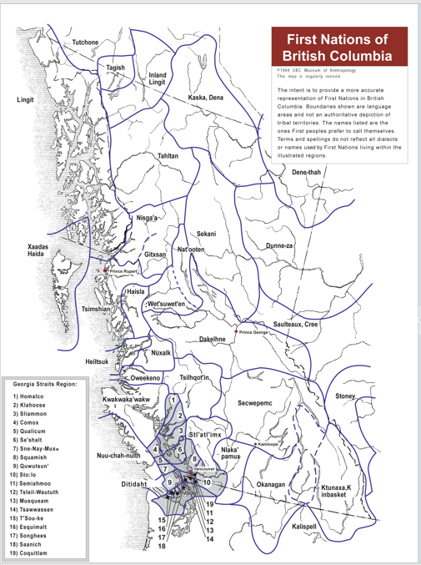
Land Acknowledgement
We would like to take this opportunity to acknowledge the shared traditional territory of the Coast Salish people on which our school is located.

Slide 3
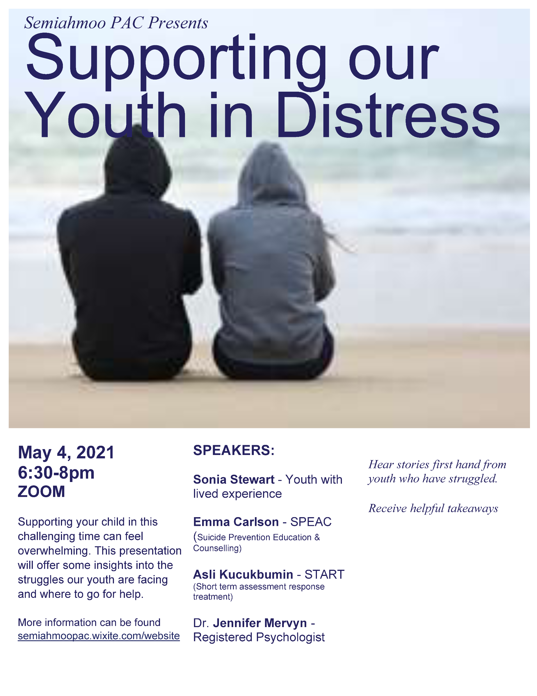

Slide 4
Sonia Stewart
- Youth with lived experience
Sonia is a first-generation Chinese Canadian on her mother’s side and a Scottish-European mix on her father’s side. Sonia completed a Bachelor of Science in Applied Biology at UBC and is passionate about using nature to support youth mental health and resiliency. She now works with youth that face barriers in the Downtown Eastside as a Youth Employment Program Coordinator with a non-profit called Environmental Youth Alliance (EYA). With EYA, she runs an environmental internship program called Roots & Shoots that focuses on developing job skills, environmental stewardship, and Indigenous knowledge of young adults. To further this work, she is also looking to complete a Master's in Counselling Psychology in the near future. When it comes to mental health challenges, Sonia has had lived experience and had family members and friends also go through mental health challenges such as depression, suicide, and much more. Part of what allowed her to grow and cope with her challenges was participating in the White Rock/South Surrey Child Youth Mental Health and Substance Use Action team for several years, where she was acted as a youth voice with lived experience. She is a strong advocate for speaking about up mental health challenges, destigmatizing mental illnesses, and bettering our current mental health care system for young people in our communities.

Slide 5
Emma Carlson
- SPEAC (Suicide Prevention Education & Counselling)
Emma Carlson (she/her) is a Registered Clinical Counsellor working with the SPEAC program through Options Community Services. She graduated from UBC with a Masters of Arts in Counselling Psychology, and is currently a member of the American Association of Suicidology. She has over a decade of experience working with youth at risk of suicide, and through her work at SPEAC, seeks to educate about the intersectionality of suicide risk, and champion her clients toward living lives that feel worth living.

Slide 6
Asli Kucukbumin
- START (Short Term Assessment Response Treatment)
Asli is a Registered Clinical Counsellor who has been working with children, youth and families for over 15 years. She has a Master’s Degree in Counselling Psychology from UBC. She has been working as a Crisis Clinician at the START program (Fraser Health) for the last seven years.

Slide 7
Jennifer Mervyn
- Registered Psychologist
Dr. Jennifer Mervyn was acknowledged by CAMH as one of the 150 Canadians making a difference in mental health. She is a Registered Psychologist with an extensive background in trauma and substance abuse and utilizes innovative, culturally informed, therapeutic approaches in her work.
Jennifer is Métis, mother of four, and strong advocate for the indigenous community. She consults, teaches, and trains on Trauma Informed Practice and policy nationwide.

Slide 8
Upcoming PAC Presentations and Meetings
Details will be updated on https://semiahmoopac.wixsite.com/website
May – Elections, call for nominees
June - Budget

