Slide 1
EMOTIONAL WELL-BEING
and
POST-SECONDARY PLANNING
A presentation to the Semiahmoo Parent Community
November 29, 2021.
Christy de Bulnes | christy@togethercounselling.ca
Michelle Robertson | michelle@togethercounselling.ca

Slide 2
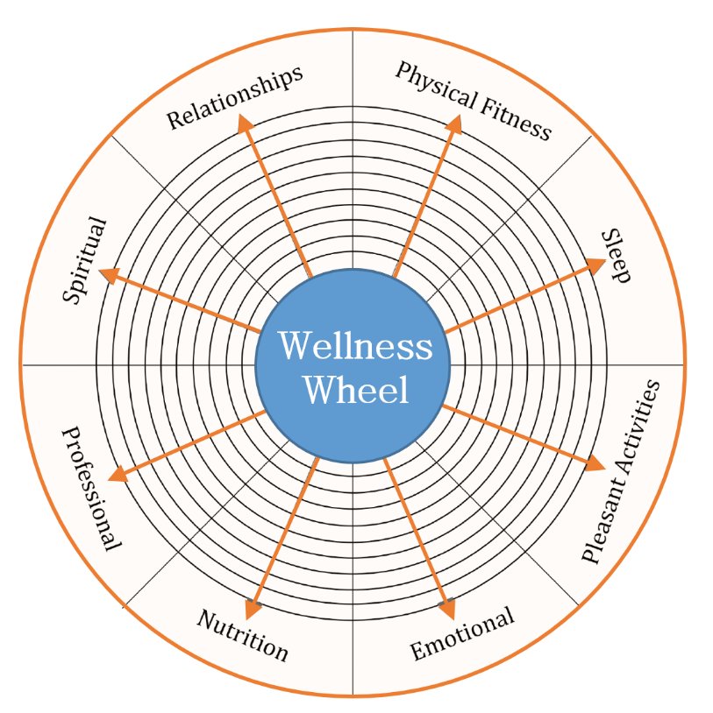
The Wellness Wheel
We find balance when we can have similar levels of wellness in each of the domains.
We can combine different domains to achieve wellness.
Today, we will focus on the emotional part of the wellness wheel.

Slide 3
Emotional Well-being
Depression = Mood disorder characterized by decreased mood, limited affect, negative thinking, decreased motivation and energy, poor concentration, attention and memory, fatigue, sadness, hopelessness
Anxiety = Emotion characterized by worry, repetitive and obsessive thinking, and physical reactivity. Restlessness, racing thoughts and heart rate, fatigue, panic, avoidance, irritability, changing behaviours.
Stress = The + - reaction that occurs when we experience a change, or something we perceive as a threat.

Slide 4
Communication during these years
New experiences + pushing boundaries = complicated parenting
Remember the “terrible twos”?
Tips to navigate the new terrain:
LISTEN – you are more likely to hear their story if you listen.
VALIDATE – what may they be feeling and show you empathize and understand.
SHOW TRUST – letting them know you have faith in them boosts their confidence.
DICTATOR – you still set the rules, but you need to be ready to explain them.
PRAISE – looking for positives.
YOUR EMOTIONS – breathe, count to ten – you are modeling how to manage difficult emotions.
TIME TOGETHER – embrace opportunities to be in proximity with each other.
SHARE MEALS – no phones at the table.
BE OBSERVANT – have there been changes in behaviours, energy levels, etc.

Slide 5
Your Script (and theirs)
I understand…
However, I am/ think/ feel…
Can we agree…

Slide 6
Anxiety is a normal, functional human emotion. It’s something that serves as an important survival function.
Sometimes it can get ‘over-sensitive’ to our surroundings and not provide us with any ways to resolve what’s going on.
Anxiety/Stress

Slide 7
When anxiety gets overloaded, it starts spinning in a cycle, as your brain is trying to figure out how to keep you safe.
This is when anxiety becomes unhealthy…when you can not break the spin cycle.
Anxiety Cycle

Slide 8
Recognize worrisome thoughts – the “what if’s”
Recognize how you behave when anxiety is with you…do you lash out (fight), avoid doing things (flight), or do you go numb (freeze)?
Notice what’s happening in your body – sweaty palms, increased heart-rate.
Thoughts, Body, Behaviours

Slide 9
What are you thinking about – write it down.
Challenge your stinky thoughts.
Tell yourself helpful thoughts.
Allow your thoughts to come…and go.
Uncertainty becomes your friend not enemy.
Be kind to yourself.
Antidote…for your thoughts:

Slide 10
Practice healthy eating habits.
Practice good sleeping habits.
Avoid drugs and alcohol.
Exercise.
Antidote…for your body:

Slide 11
Learn how to chill by practicing calm breathing, mindfulness, meditation, or progressive muscle relaxation.
Antidote…for your behaviours:

Slide 12
If anxiety is thinking about what’s going to happen in the future, depression is thinking about what has happened in the past.
Depression

Slide 13
Resilience
A person’s ability to ‘bounce back’ to their usual manner of functioning
Ingredients include:
Disposition
Beliefs
Previous experiences
Self-understanding
Self-care
Engagement

Slide 14
3 Key Components:
Adaptability
ACTING
THINKING
FEELING

Slide 15
Resilience + Adaptability
Resilience is not everything – bouncing back is important but it’s also important to learn how to adjust.
Help your students recognize when a novel situation arises how they can tap into their past experiences to adjust to this new situation.

Slide 16
Getting help:
School counsellors
Community agencies
Private therapists
Family Doctors
Online sources

Slide 17
Post-Secondary Planning
Notes:
Hello, My name is Michelle and I work with students and families as they look ahead to post secondary planning. Tonight I am going to provide a general overview of the exploration and application process as students look ahead to life after high school.

Slide 18
Ways to Support Your Student
|
|
|
|
|
|
|
|
|
|
|
|
|
|
|
|
|
|
|
|
|
|
|
|
|
|
|
|
|
|
Understanding the process
Overview of key dates
Current trends
Help them be prepared for what’s ahead
Notes:
Post Secondary Planning is a process. For some students it may begin early in high school, or it might start in the grade 12 year, there are a number of ways to reach post secondary goals. A few ways that you can support your students as they look ahead to life after high school.
Understand that this is a process, and there are often a number steps that need to be completed. Research, course planning and understanding specific requirements. What is required by one school / program is not necessarily the rule for all schools. Do you research!
Have open conversations. What are family boundaries? Are you looking at schools and programs across Canada or close to home?
What area of study sounds interesting? Does the student understand what classes are required for admission and what courses are required once admitted to the program? (For example, psychology at UVIC requires a year of biology, a computer science and a math class – yet it is not a science program, is this OK?) What do you, and your student, want from the post secondary experience?
Key Dates – Depending on the grade and stage that you are in, these can be different. We will discuss this more when we look specifically at the grade 12 year.
Current trends – Students are hunting programs and looking to combine interests. Engineering & Business, Kinesiology & Dance, Visual Arts & Computer Science. As well they want perks – Co-op (paid work experience) study abroad, varsity sports, or a specific campus community.
Universities are looking at more than just grades, and not just grade 12 marks. Participating in enrichment programs or activities in high school can help identify strengths and interests.
Help them prepare – start the conversation now - and understand the importance of research, time management & executive functioning skills. Two things to be mindful of – Often, what you need to do to be admitted AND what you need to do to do well when you get there can be different. Courses like a Language 12, Calculus and Physics might be more important than you think.

Slide 19
College/University Vocabulary
Word | Definition | Word | Definition | Word | Definition
Major | Main subject area of study | Bachelor’s Degree | Typically, a four-year undergraduate study program | Program Certificate | A short-term specialized program, normally completed within one year
Minor | A secondary field of study with less than 30% of the full degree course load | Master’s Degree | A post-graduate degree in a specific academic area | Credit/Unit | A measured value of a university or college course that goes towards graduation requirement
Specialization | The primary concentration or focused area of study (similar to a major) | Diploma | A short-term program that focuses on an area of study, usually completed in two years. | Co-op/Internship | Paid practical work experience earned towards your degree
Notes:
Visiting post secondary websites can be a great place to begin. Take virtual tours, explore programs, and review degree requirements. But before you do, it can be helpful to understand the vocabulary. What is the difference between a diploma and a degree? What are majors, minors and specializations? Understanding this will help you learn more about what might be a good fit for you

Slide 20
Current Trends
Find the right fit
It’s not one-size-fits-all
Grade 11 matters
Involvement matters
Clubs, hobbies, volunteer, work
Notes:
There are so many ways to begin post secondary studies and finding the right fit is key. It is not one size fits all. Do you want to begin in a large environment, a small program, go across the country and be close to home? What do you want in a post secondary experience and what will provide a great fit. Many ranking systems will note the best business or science program, but is it the best for your student?
Many of the larger universities , or for unique programs, schools are looking at both grade 11 and grade 12 marks for admissions. Grade 11 marks are particularly important for students working in a semester system. Offers are made before the end of the grade 12 year – in the absence of a required course (science math or English) the grade 11 mark will be used as a predictor.
Finish grade 11 strong!
Many programs – creative industries, engineering, business, health science and all UBC programs will look at grades and use
an additional supplemental application ( this could include essays, portfolio, resumes or an interview)
They often ask about a number of extracurricular activities and interests. They want to know that you are engaged with your community, and are willing to try new things. An Example from UBC’s general application “Tell us about who you are, how would friends family and member of the community describe you and what are you most proud of an why” They want to know what you have learned about yourself through unique experiences.
Almost every scholarship application asks for a list of activities from grade 10-12, what you did, and what you learned through the process. Look for opportunities now and begin making notes, this will be helpful when you enter this phase of the process. Limited opportunities during the pandemic requires creative initiatives – it cannot be used as a reason for limited involvement. One of UBC”s questions – Tell us how the pandemic has changed how you interact with the activity or group most important to you? What have you learned about yourself through this?
They want to hear how you found new or interesting ways to stay connected.

Slide 21
Timeline of Key Activities
Confirm your short list of schools and programs
Oct application portals open
Dec-Feb
Submit/self report grades/transcripts
Apr
Decision making
Summer
Fall
Winter
Spring
Nov/Dec
Supplemental writing and early scholarships
Feb/Mar
Late scholarship applications, research
May/Jun
Housing applications and course planning
Notes:
This timeline is a guideline. Some students have been planning for post secondary since high school started, and for some they are just beginning to explore options in the grade 12 year. It is a process and not typically something that can be done in a weekend. For current grade 12 students encourage them to participate in virtual tours or online information sessions. Research admission requirements and look at program structures. Talk about fit, what does the student want in a post secondary experience? What are historical admission averages? Based on this, create a shortlist of schools and programs. Submit applications, draft any written supplements, and watch emails for next steps. It is a busy time. Create a plan, map out a timeline, and tackle tasks one at a time.
Fit matters, the size, the program and community will all play a role in how well your student does in their first year of studies.

Slide 22
Grade 11 – the process begins
Get Involved!
Extracurricular activities not only build your personal profile, but also help you learn about your likes, interests and strengths. Knowing this helps you decide what you might want to pursue in post secondary
Be Creative!
There are a lot of things that you cannot do right now, but there many that you can do. Think of creative ways to stay engaged with your community and activities that you enjoy.
Grade 11 matters!
Most Universities make admission decisions based on final grade 11 marks and first term, grade 12 marks. For semester students, in the absence of a grade 12 mark, a grade 11 mark will be used
Notes:
Universities and colleges will often issue conditional offers of admission early or mid-way through the grade 12 year. This is typically based on grade 11 academic achievement. This is also true for scholarship decisions. Finishing grade 11 strong, and a solid start in grade 12 will help set you up for success. This can be particularly important for semester students. If a key course (English or Math) is not until second semester, schools will look at the grade 11 mark as a predictor)
As mentioned, many programs in universities will look at more than just grades when they are evaluating a student’s application. Being an active member of your school community, having hobbies, working part time all build valuable skills, and make you a more attractive candidate. In addition, these experiences will help students learn about different work environments, what they enjoy, and what skills they have. These can all help when you are working towards identifying the school and program that they want to apply for.
Jr Achievement, BCCH Mini Med School, UBC’s Geering Up – all great ways to learn about your strengths and be engaged. And, they all ran through the pandemic.
Many things are different this year, sports teams can’t compete, volunteering opportunities may be in short supply, and enrichment programs are on hiatus. Having said that, there is still a lot that can be done. Thinking about a career in health care but can’t volunteer at the seniors center…..write letters or send postcards. Thinking about teaching or coaching - couldn’t be a counsellor at summer camp ….. Volunteer to support younger family members, friends, or neighbors via online channels, host story time or play games. Sports are on hold – create a group chat and share at home workout routines with teammates. Stay engaged, stay connected.

Slide 23
Grade 10 – planning ahead
Get Involved!
Try it all, learn about what you like and don’t like. In grade 11 keep what you enjoy most.
Start the conversation and research
On summer holidays, in a new city, take a campus tour. Talk to friends and family members about their experience, and start looking at websites.
Grade 10 is what grade 11 ‘used to be’
This is the year to learn how to learn well.
Notes:
For years when I would meet with students just before their grade 12 year started they would say – “My grades are going to be way better this year. I know that it matters” Six years ago you could be admitted to UBC based on four academic 12 courses. So, doing well in grade 12 really was what was needed. Today, they evaluate applications based on 6-8 grade 11 and grade 12 courses. You cannot gear up in grade 12 and expect great results.
In grade 10 begin building strong study habits o nightly review, learn to communicate with your teachers, keep a schedule, hand in assignments on time and learn how you learn well. Do you need extra help, do you need to write out notes, make flash cards or watch youtube videos? Figuring this out in grade 10 often means a strong start in grade 11 and solid habits for grade 12.
Get involved – try out for the school play, join the environmental club, teach yourself to knit or how to play the guitar, and babysit your neighbors. In grade 11 and 12 you want to cultivate your list of activities to what you really enjoy. You don’t know unless you try.

Slide 24
Summary
Post-secondary is a process
Start early, do your research, and set goals
Let your student manage the process, with you as their safety net
There are a number of ways to reach an end goal
Grade 11, and being involved matters in post-secondary admission decisions

Slide 25
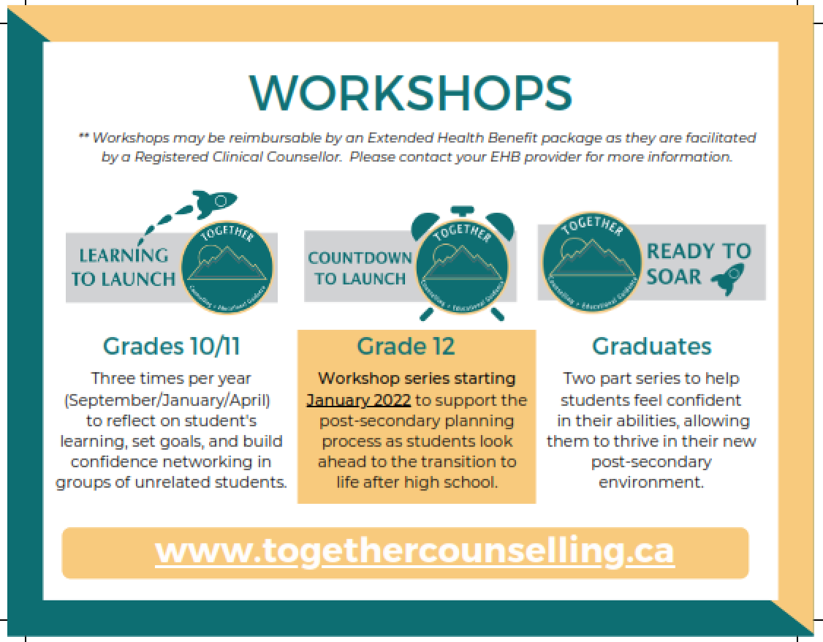

Slide 26
Questions?

